Slide 1


Future Interns
Business Sales
Performance Analysis
Jacob Maina
10th October 2025

Slide 2


Introduction to
Business Analysis
Overview
Purpose of This Analysis
Business analysis helps organizations use data to identify trends, measure performance, and make informed decisions that drive growth.
To explore e-commerce sales data (2009–2011) and uncover insights on best-selling products, sales trends, and top-performing regions to support better business decisions.

Slide 3
Data Description
The dataset used in this analysis is the Online Retail II dataset, which contains all transactions for a UK-based, non-store online retailer between 1st December 2009 and 9th December 2011.
The company mainly sells unique all-occasion giftware, and many of its customers are wholesalers.
Dataset Summary
Key Data Columns
Source: Online Retail II
Period Covered: 01/12/2009 – 09/12/2011
Business Type: UK-based non-store online retailer
Main Products: All-occasion giftware
Customer Type: Mostly wholesalers
InvoiceNo: Transaction ID
StockCode: Product code
Description: Product name
Quantity: Items sold
UnitPrice: Price per unit (£)
InvoiceDate: Transaction date/time
CustomerID: Customer ID
Country: Customer location

Slide 4

Data
Preparation and Analysis
Excel
SQL
Power BI
Checked and corrected data types for all columns
Added OrderDetail column to flag valid and invalid invoices
Created Sales column (Quantity × UnitPrice)
Merged 2009–2010 and 2010–2011 datasets
Removed duplicate records
Handled missing values
Imported cleaned dataset
Created measures for key KPIs
Built interactive dashboards for data visualization

Slide 5
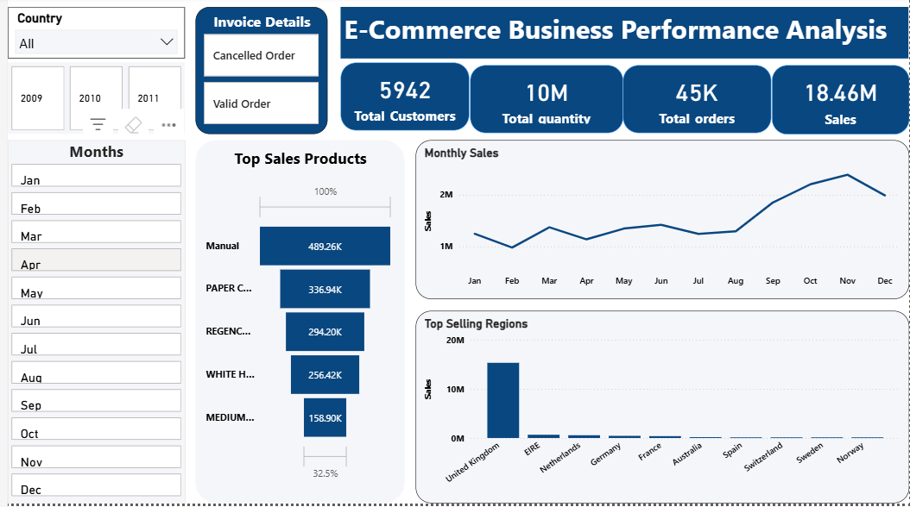
Dashboard Overview
Provides a clear view of overall-business performance.
Highlights top-selling products, sales trends over time, and top-performing regions.
Displays key KPIs:
Total Customers
Total Quantity
Total Orders
Total Sales/Revenue
Includes interactive filters:
Country – shows sales by region
Year & Month – tracks sales performance over time
Invoice Details – distinguishes valid and cancelled orders
Enables users to analyze trends, monitor performance, and make informed business decisions.

Slide 6
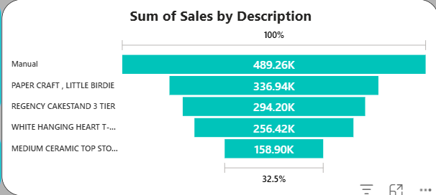
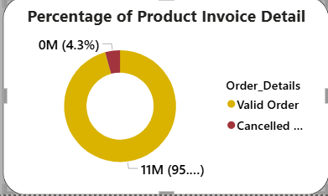
Business Product Performance Analysis
Manual Description product recorded the highest total sales between 2009 and 2011.
The chart displays the top 5 best-selling products based on total sales.
Pie chart shows the percentage of valid vs. cancelled invoices.
Products with valid invoices represent the largest quantity sold, indicating stronger sales performance.

Slide 7
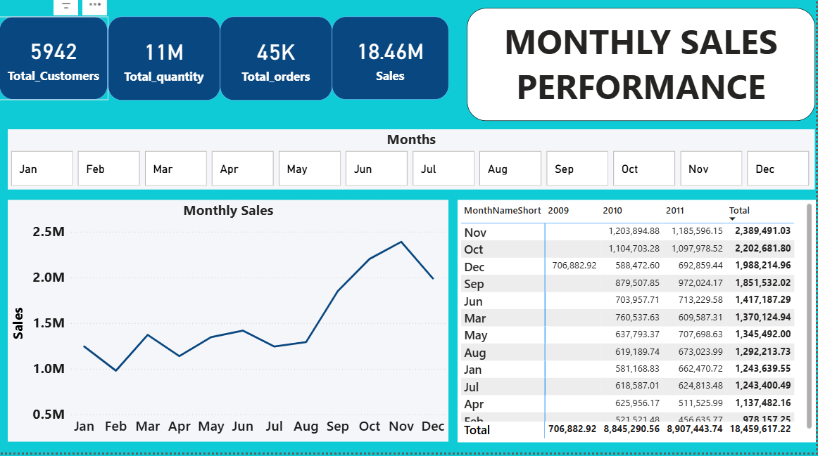
Monthly Sales Performance Analysis
November, October, December, and September recorded the highest sales performance.
November shows the peak sales month across all years.
Overall sales display an upward trajectory over the months between 2009 and 2011.
Indicates strong seasonal trends, with increased sales toward the year-end period.

Slide 8
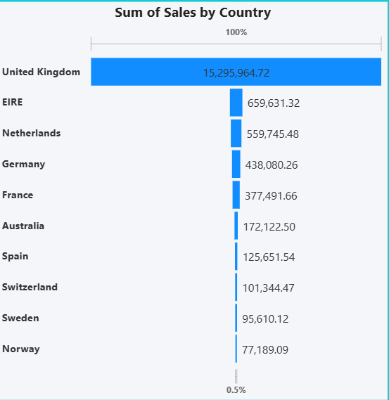
Regional
Performance Analysis
United Kingdom recorded the highest total sales among all regions.
The chart highlights the top 10 regions contributing most to overall revenue.
Shows clear regional variations in sales performance.
Indicates the UK as the primary market, with other regions showing potential for growth.

Slide 9
Recommendations :
Focus on best-selling products such as Manual Description to maximize revenue.
Boost marketing and inventory during peak months (September–December) to take advantage of high demand.
Address low-performing months (e.g., February) with targeted discounts, campaigns, or promotions to drive sales.
Strengthen business operations and maintain customer loyalty in the United Kingdom, the leading market.
Expand into emerging regions showing potential sales growth through localized marketing and product offerings.
Implement customer engagement strategies like loyalty programs or personalized offers to increase repeat purchases.

Slide 10
Future Interns
THANK YOU
FOR YOUR ATTENTION
MUCHOKI JACOB

